Slide 1

Basic Details of the Team and Problem Statement
Ministry/Organization Name/Student Innovation: All India Council for Technical Education (AICTE)
PS Code: DR708
Problem Statement Title: AI based tool to get information about 5 good institutes based on AISHE data.
Team Name: Mahoot
Team Leader Name: Shivani Rawat(Female)
Institute Code (AISHE): C-46112
Institute Name: ABES Engineering College, Ghaziabad
Theme Name: Smart Education

Slide 2
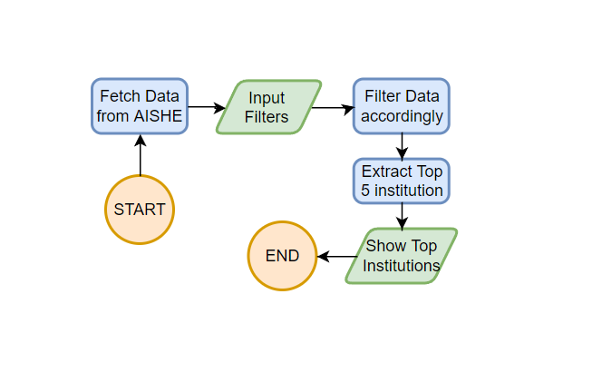
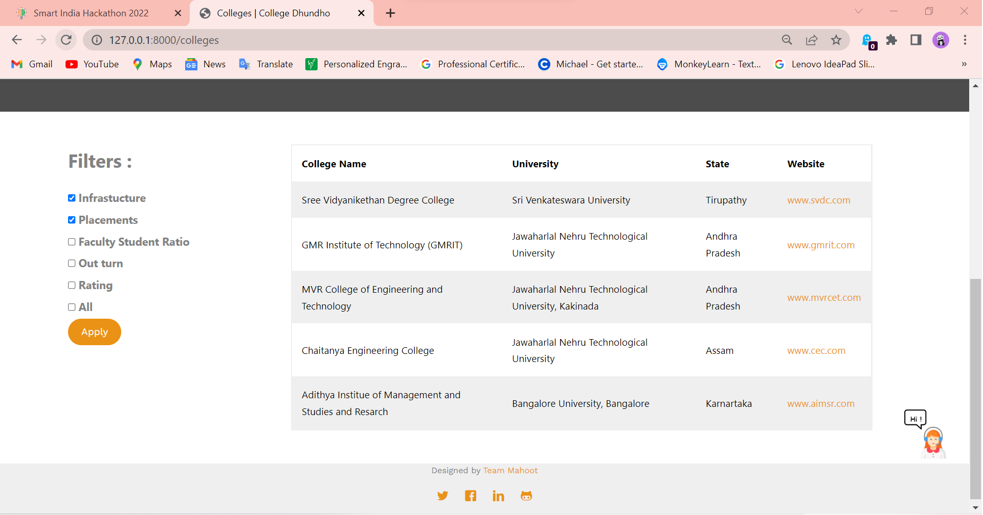
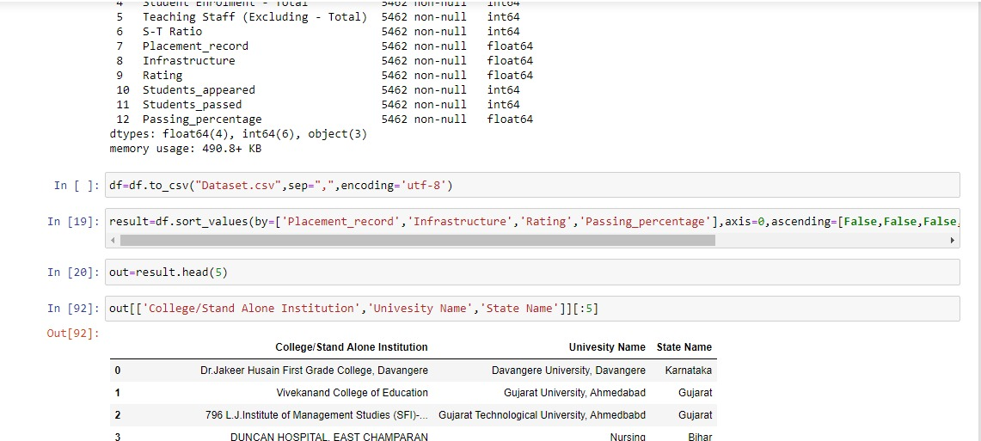
Idea/Approach Details
Describe your idea/Solution/Prototype here:
IDEA: To create a portal to find 5 good institutes based on AISHE data according to applied filter(s).
Solutions: College Quest – a web based portal, having ML algorithms in backend to analyze rankings of colleges, with chatbot for better interaction.
Prototype:
Describe your Technology stack here:
HTML
CSS
JavaScript
Django
Data Analysis
Artificial Intelligence

Slide 3
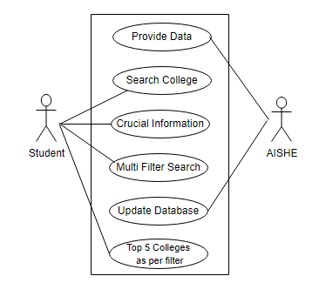
Idea/Approach Details
Describe your Use Cases here
Describe your Dependencies / Show stopper here
Dependency:
1) AISHE Portal data
2) System
3) Internet Connection
Show Stopper :
1) Using AISHE survey data to rank colleges
2) Using multiple filters to get the best college of the choice.
3) Help college to analyze the reason for depreciation in ranking.

Slide 4
Team Member Details
Team Leader Name: Shivani Rawat
Branch: B.Tech Stream: CS Year: III
Team Member 1 Name: Geetanjali Sharma
Branch: B.Tech Stream: CS Year: III
Team Member 2 Name: Yash Varshney
Branch: B.Tech Stream: CS Year: III
Team Member 3 Name: Shreyansh Sahai
Branch: B.Tech Stream: CS Year: III
Team Member 4 Name: Shubham Raj
Branch: B.Tech Stream: ECE Year: III
Team Member 5 Name: Pradumn
Branch: B.Tech Stream: ECE Year: III
Team Mentor Name: Rohit Vashisht
Category: Academic Expertise: AI/ML Domain Experience: 6.5 years

